Slide 1
Software Installation
Anaconda Distribution
Python 3.7
Jupyter Notebook
Numpy
Pandas
Matplotlib
Scikit-learn
Tensorflow

Slide 2
Supervised Machine Learning techniques
Linear Regression
Logistic Regression
Decision tree
Naïve Bayes
Support Vector Machine

Slide 3
Steps in Machine Learning
Import the packages required
import pandas as pd
import numpy as np
import matplotlib.pyplot as plt
2. Load the Data
df = pd.read_csv('data.csv’)
3. Split the data into Training set and Test set
train_test_split( ... X, y, test_size=0.33, random_state=42)
4. Train the model using Training set : fit(Xtrain,Ytrain)
5. Test the model Test set : predict(Xtest, Ytest)
6. Evaluate the performance of the model

Slide 4
Performance Metrices
Persons | Actual label | Predicted label
P1 | Diabetic | Diabetic
P2 | Not Diabetic | Not Diabetic
P3 | Diabetic | Diabetic
P4 | Diabetic | Diabetic
P5 | Diabetic | Not Diabetic
P6 | Not Diabetic | Not Diabetic
P7 | Diabetic | Diabetic
P8 | Diabetic | Diabetic
P9 | Diabetic | Diabetic
P10 | Not Diabetic | Diabetic
Label | Prediction | Category
1 | 1 | True Positive
-1 | -1 | True Negative
-1 | 1 | False Positive
1 | -1 | False Negative
True Positive : 06
True Negative : 02
False Positive : 01
False Negative : 01
Accuracy: TP+TN / TP+TN+FP+FN
Accuracy : 08/10= 80%
Precision: TP/ TP+FP
Recall : TP/ TP+FN

Slide 5
Linear Regression
Used Mainly for Prediction & Estimation
It is a linear approach to modelling the relationship between a scalar response (or dependent variable) and one or more explanatory variables (or independent variables).
The case of one explanatory variable is called simple linear regression.
The simplest form of the regression equation is: y = c + b*x
where, y = estimated dependent variable score
c = Constant
b = regression coefficient
x = score of the independent variable
Does the given set of predictor variables are good enough in predicting an outcome (dependent) variable?
Which variables in particular are significant predictors of the outcome variable?

Slide 6
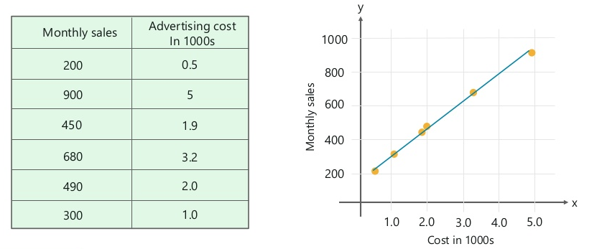
Forecast monthly sales by studying the relationship between the monthly e commerce sales and the online advertising costs

Slide 7
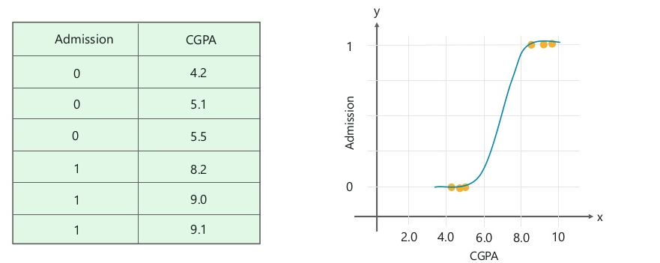
Logistic Regression
To predict is a student will get admitted to a school based on his CGPA

Slide 8
 | Linear Regression | Logistic Regression
Variable type | Dependent variable is continuous | Dependent variable is binary in nature
Type of problem | Solves regression problems | Solves categorical problems
Best fit line | Straight line | S Curve
Applications | Business domain, Forecasting sales | Classification problems, Cyber security, image processing

Slide 9
Naïve Bayes
Supervised Learning algorithm based on Bayes Theorem.
Bayes Theorem P(A|B) = P(B|A) P(A)
P(A ) : Prior probability, P(B|A) : Posterior probability
P(B)
Text Category
“A great game” Sports
“The election was over” Non Sports
“very clean match” Sports
“A clean but forgettable game” Sports
“It was a close election” Non Sports
“A very close game” ?
Total words in sports : 11
Total words in non sports : 9
Total unique words in the dataset : 14
P(sample|Sports) = P(A|Sports) * P(very|Sports) * P(close|Sports) * P(game| Sports)
= 2/11 * 1/11 * 0/11 * 2/11
= 0

Slide 10
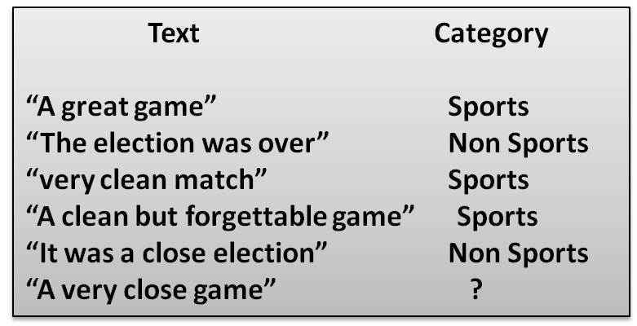

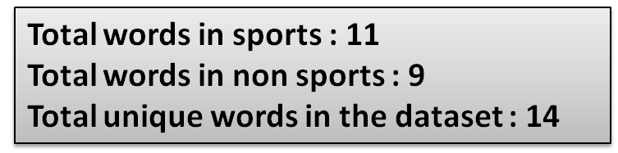



Laplace smoothing
α> 0, default value 1
d is the number of unique words in the document
P(word) = (word count + 1)/ (total no. of words + No of unique words )
P(close|sports) = p(A|sports) =
P(very|sports) = p(game|sports) =

Slide 11
Word | P(word|sports) | P(word|non sports)
A | 3/25 | 2/23
Very | 2/25 | 1/23
Close | 1/25 | 2/23
game | 3/25 | 1/23
P(sample|Sports) = P(A|Sports) * P(very|Sports) * P(close|Sports) * P(game| Sports)
= 0.0000461
P(sample| non Sports) = P(A| non Sports) * P(very| non Sports) * P(close| non Sports) * P(game| non Sports)
= 0.0000143
P(sample| Sports) is high. Therefore it belongs to sports category

Slide 12


Decision Tree
Employed?
Entropy Function, Information, Gain
NO
YES
Employed | Credit score | Income | Label
Yes | Low | High | Approve
Yes | High | Low | Reject
No | Low | High | Reject
No | High | High | Approve
Credit score?
Income?
High
Low
High
Low
Approve
Reject
Approve
Reject

Slide 13
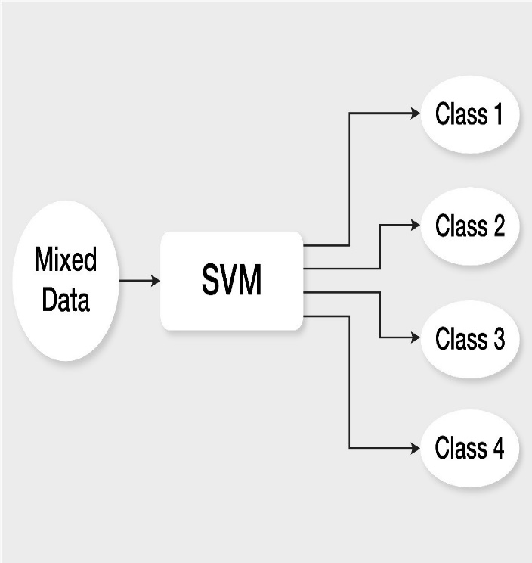
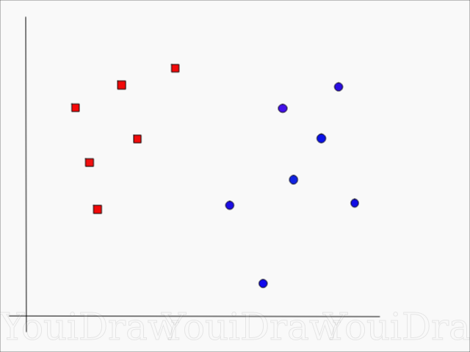
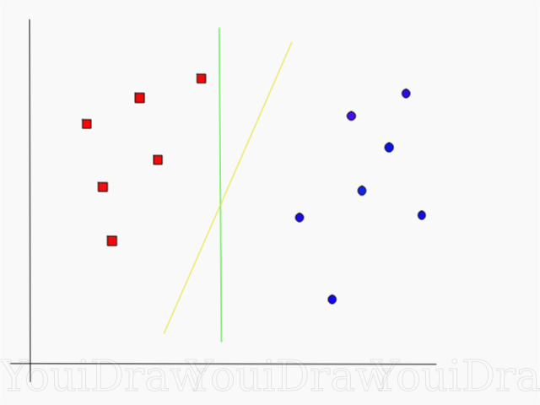
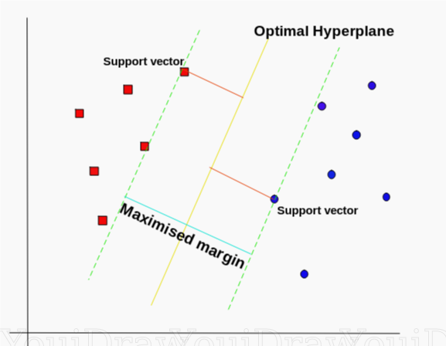
Support Vector Machine
Support vector machines (SVM) are supervised learning models with associated learning algorithms that analyze data used for classification and regression analysis.
SVM Classifier
Find an ideal line/ hyperplane that separates this dataset into red and blue categories
Which line according to you best separates the data???
Non-linearly separable data

Slide 14
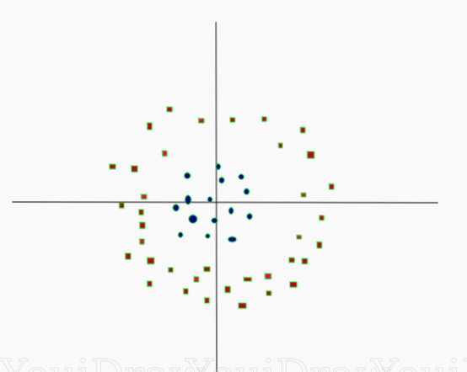
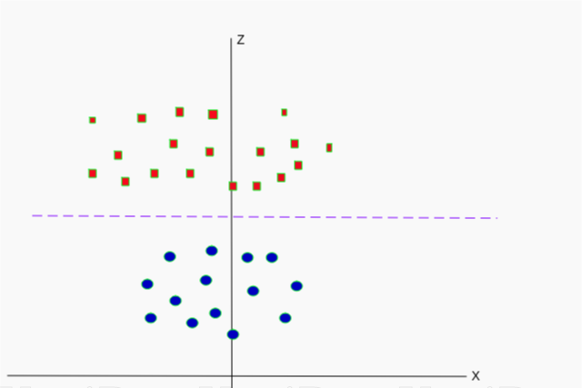
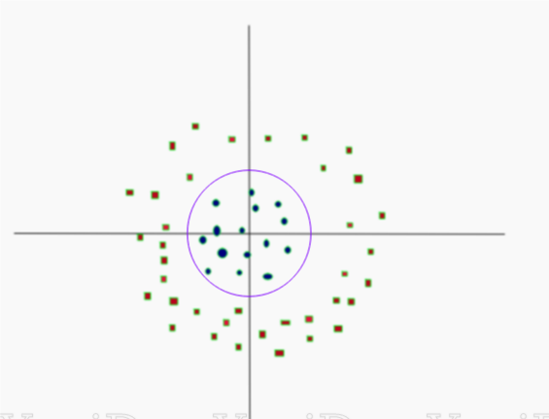
purple line separating the data in higher dimension be z=k, where k is a constant. Since, z=x²+y² we get x² + y² = k; which is an equation of a circle.
Non-linearly separable data
Dataset on higher dimension
z = x²+y²
Decision boundary in original dimensions

Slide 15
Linear Regression & Logistic Regression using Tensorflow

